Slide 1
Reducing the Service Function Chain Backup Cost over the Edge and Cloud by a Self-adapting Scheme
Xiaojun Shang , Yaodong Huang , Zhenhua Liu, and Yuanyuan Yang , Fellow, IEEE

Slide 2
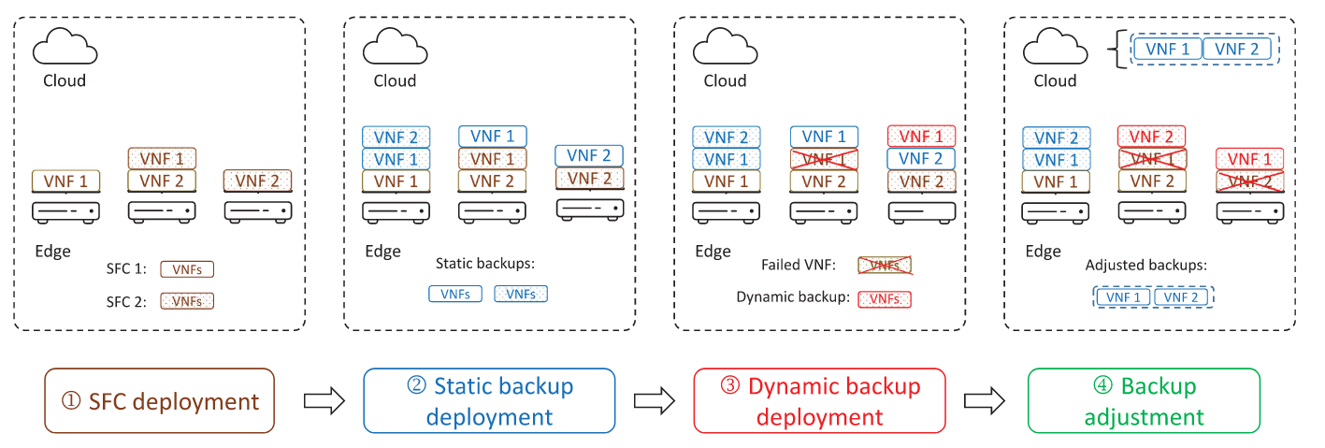
Backup method

Slide 3

Python脚本语言的一个库，使用户能够描述数学程序。
提供代表优化问题和决策变量的Python对象
具有线性优化能力
PuLP的重点是支持线性和混合整数模型。

Slide 4

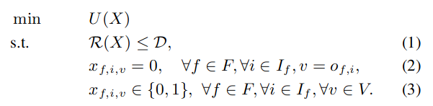

Static Backup Depolyment Stratege
Aim: minimize backup cost :
By deploying backup onto the edge servers as much as possible.

Slide 5
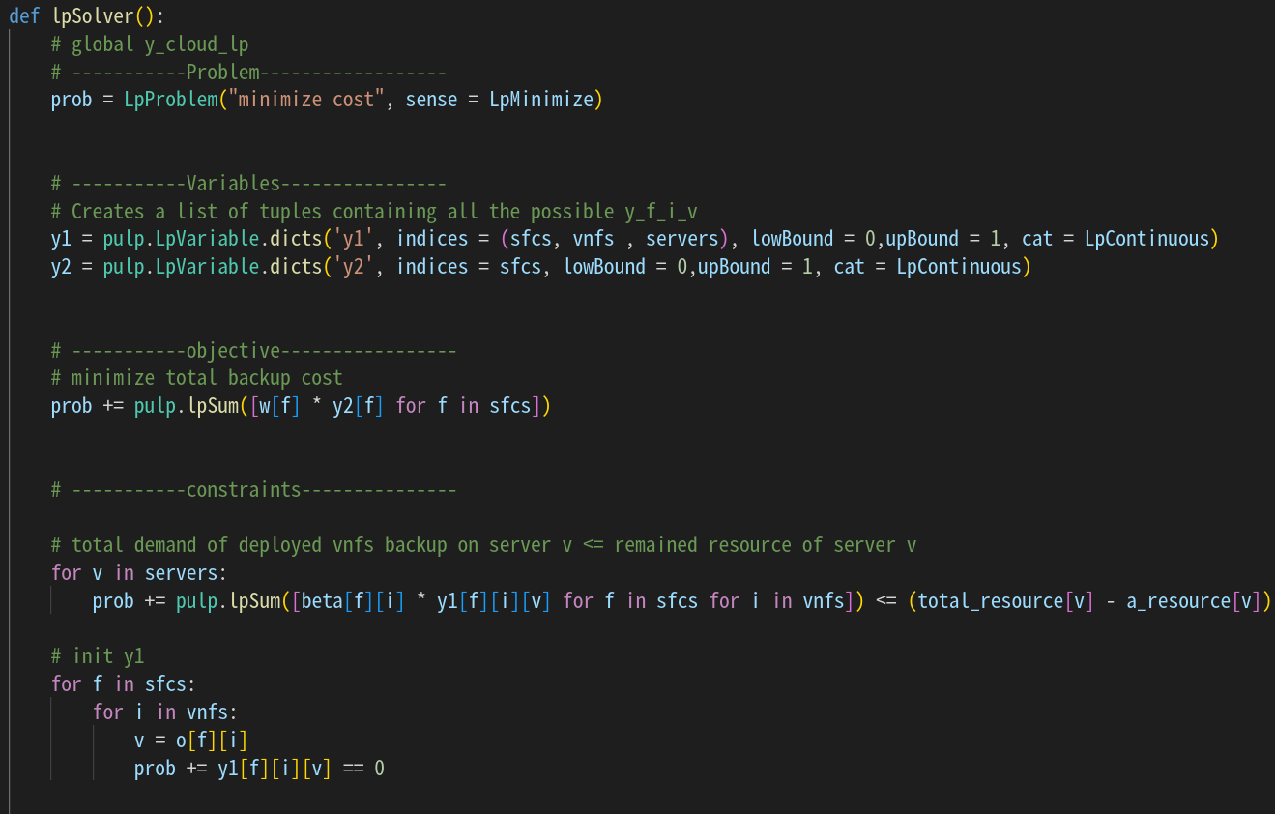

Slide 6
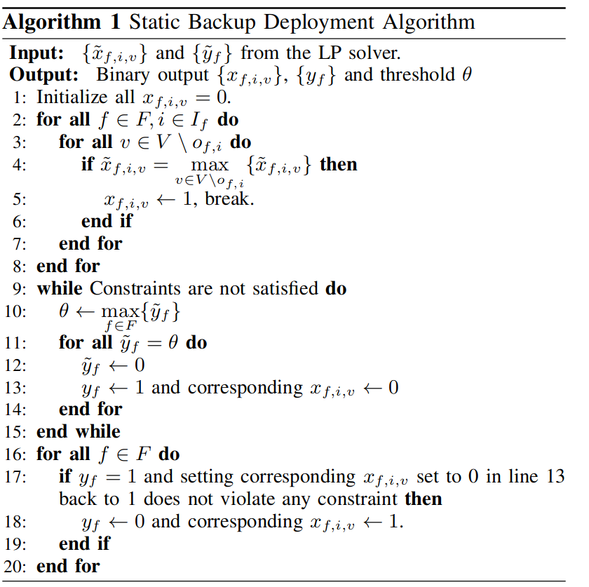
Static ackup depolyment algorithm
2-8 line:
transform [0,1] to {0,1}
9-15 line:
backup into cloud server
16-20 line:
check again whether it can be placed on the edge servers

Slide 7
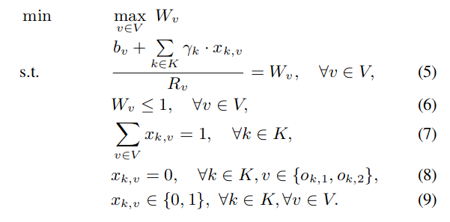
Dynamic Backup Depolyment Stratege
Aim: assure the avalability of SFCs & minimize servers’ load :
By deploying more backup automatically & adjusting the dynamic backups.

Slide 8
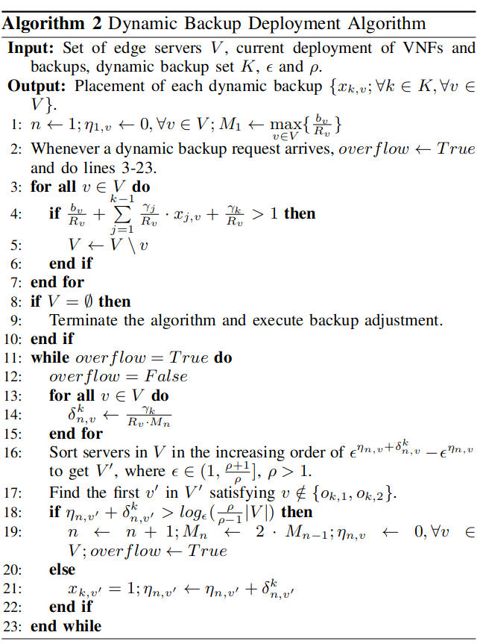
Dynamic Backup Deployment Algorithm
3-7 line:
select the qualified servers
11-23 line:
calculate some parameters, such as the load of each servers before deploying the dynamic backups. These parameters decide which server the VNF(dynamic backups) should be placed on.

Slide 9
SFC Backup Adjustment
During the deployment of dynamic backups, there exist situations that there are not enough resources to deploy the next dynamic backup. This means more VNFs are currently unavailable on the edge, and we need more resources to deploy daynamic backups.
There are also opposite cases that edge resources are excessive and more SFCs can be backed up on the edge to save cost. To deal with these situations, RAD further moves backups of SFCs between the edge and the cloud to balance the availability and backup cost.
Simplified, we depoly more dynamic backup when edge resources are sufficient, and adjust the SFCs to the cloud when edge resources are not enough.
When edge resources are not sufficient, Algorithm 2 will be terminated. Then it sort SFCs backuped up on the edge and pick the SFC f with the smallest w_{f}. We the back up SFC f in the cloud instead and the SFC f and its static backups are released from the edge. Algorithm 2 starts again.
The adjustment method also maintains t. When t grows larger than a predefined threshold t₁, the method deploys static backups for each VNF of SFC f which has the largest w_{f} on the cloud.
If t continuously increases and becomes larger than another threshold t₂, the SFCs which has been moved to the cloud previously will placed on the edge again.

Slide 10
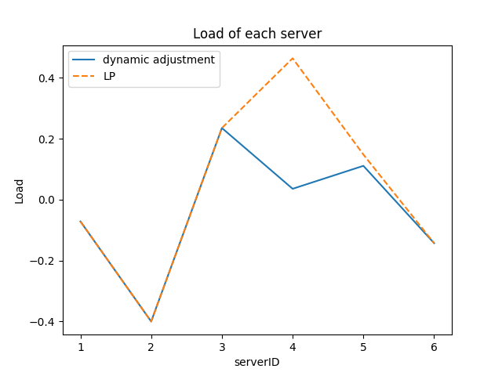
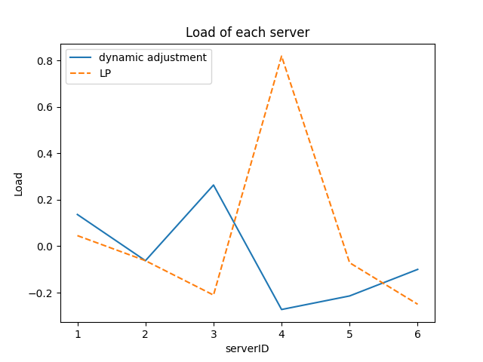
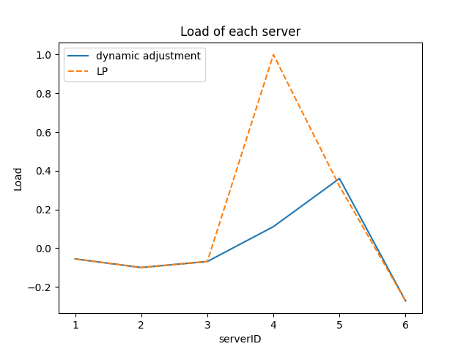
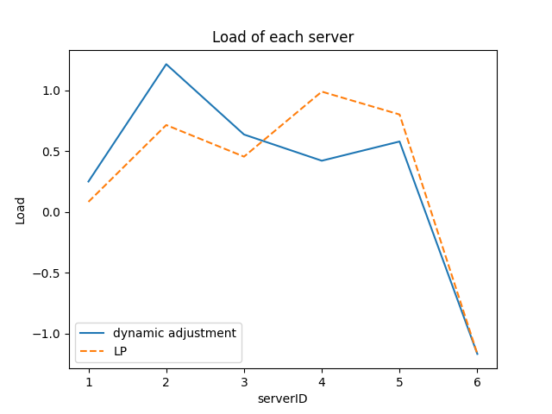
Load of each server

